Slide 1
Normalizing Flows
Narsil Zhang

Slide 2
Main Purpose: Density Estimation

Slide 3
Target: Find a invertible transformation f s.t. $z=f\left(x\right)$
Or, find a series of transformations fi s.t. $z=f\left(x\right)=f_{n}(…\left(f_{2}\left(f_{1}\left(x\right)\right)\right))$

Slide 4
With a parametric model fi(·), how can we train it?
Maximum Likelihood
or minimize:

Slide 5
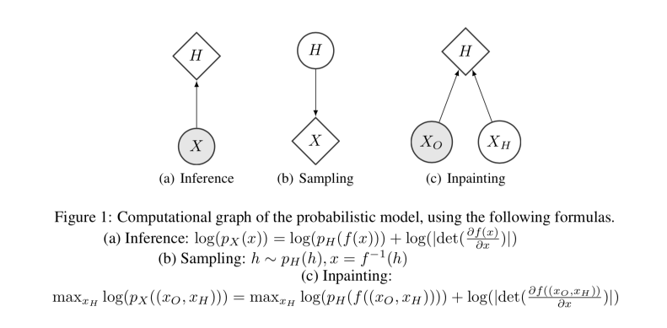
With trained f, we can:

Slide 6
Outline: Different Ways of Modeling F
Planar flow & Radial flow
Autoregressive : IAF & MAF
Partitioned : NICE & Real NVP & Glow
Continuous: Neural ODE & FFJORD & DDNF

Slide 7
Variational Inference with Normalizing Flows
Planar flow

Slide 8
Radical flow

Slide 9
Variational Inference

Slide 10
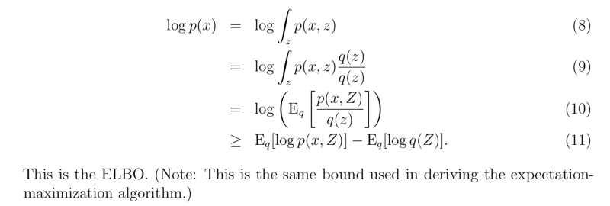

Slide 12
Autoregressive Flows

Slide 13
Masked Autoregressive Flow for Density Estimation （MAF）
Target: from normal u, generate X

Slide 14
Inverse MAF
implement the set of functions {f_μi , f_αi } with masking, following the approach used by MADE
this can be done in the mean time, for all i

Slide 15
Improved Variational Inference with Inverse Autoregressive Flow （IAF）
在IAF的论文中，用了lstm而不是MADE来实现{f_μi , f_αi }
Target: from normal u, generate X
this can be done in the mean time, for all i

Slide 16
MAF vs IAF : from U compute X
MAF:
IAF:
Sample： U->X
Estimate： X->U
MAF: sample 慢，estimate 快
IAF：sample快，estimate 慢

Slide 17
a LSTM-like IAF

Slide 18
How to implement "autoregressive"?
Use MADE: Masked Autoencoder

Slide 19
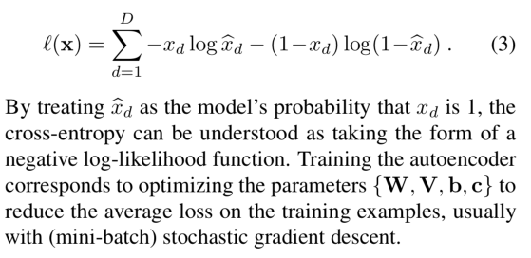
Recall Autoencoders
Suppose each input dimension x_d belongs in {0, 1}

Slide 20
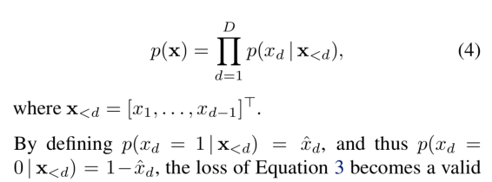
MADE: Masked Autoencoder for Distribution Estimation
Our method masks the autoencoder’s parameters to respect autoregressive constraints: each input is reconstructed only from previous inputs in a given ordering

Slide 21
Loss of autoregression model

Slide 22
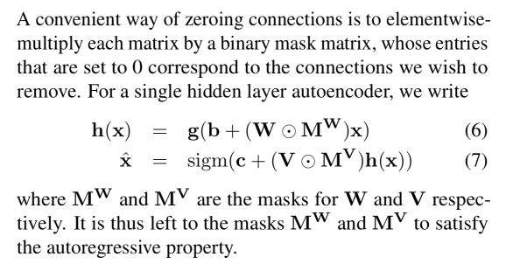
how to modify the autoencoder to satisfy the autoregressive property?
mask the weighted connections of a standard such that the output is autoregressive

Slide 23
assign each unit in the hidden layer an integer m between 1 and D−1 inclusively.
The k-th hidden unit’s number m(k) gives the maximum number of input units to which it can be connected.

Slide 25
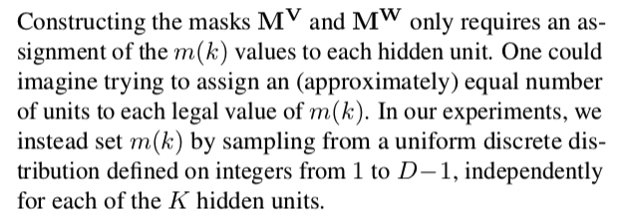

Slide 26
Deep MADE

Slide 27
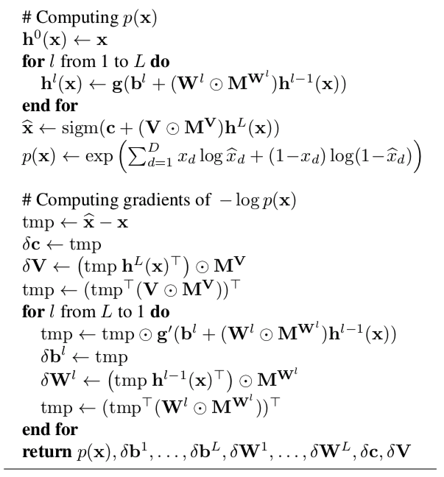

Slide 28
Partitioned Flows

Slide 29
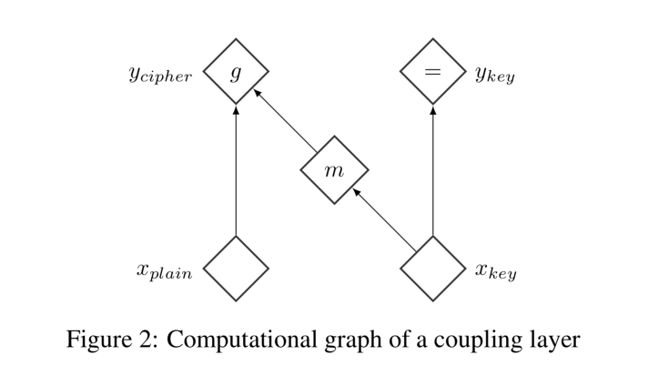
NICE: NON-LINEAR INDEPENDENT COMPONENTS ESTIMATION

Slide 30
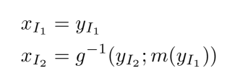
its Jacobian
its inverse

Slide 31
RESCALING

Slide 32
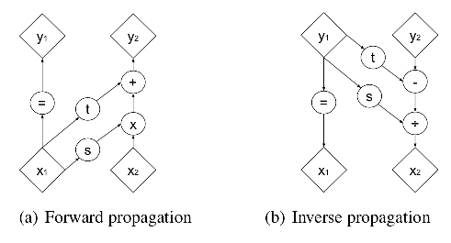
DENSITY ESTIMATION USING REAL NVP
(sequel of NICE)

Slide 35
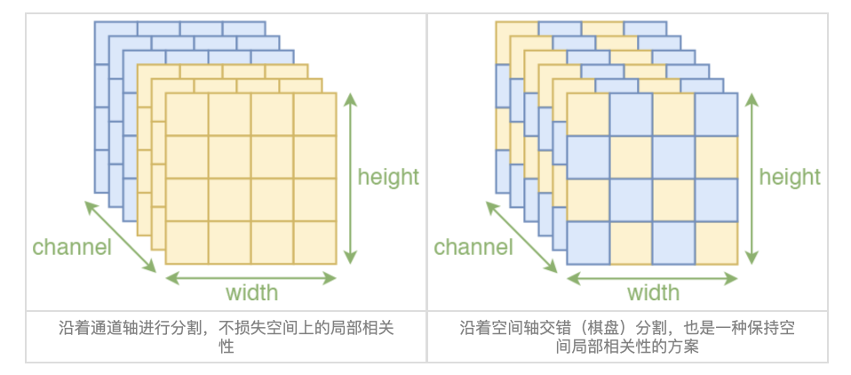
引入卷积
用卷积的前提是输入（在空间维度）具有局部相关性

Slide 36
Multi-Scale

Slide 37
Batch Normalization

Slide 38
Glow: Generative Flow with Invertible 1×1 Convolutions

Slide 39
Invertible 1 × 1 convolution
replace permutation with a (learned) invertible 1 × 1 convolution
cost of computing det(W): $O(c^{3})$

Slide 40
Reduce from $O\left(c^{3}\right)$to $O(c)$
We then only optimize $P, L, U and s$

Slide 41
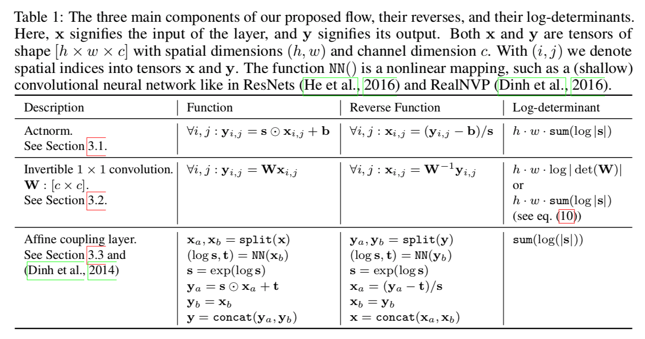

Slide 43
Continuous Flows: an ODE view

Slide 44
Neural ODE
http://arxiv.org/abs/1806.07366

Slide 45
Instantaneous Change of Variables:

Slide 47
Optimizing target:

Slide 48
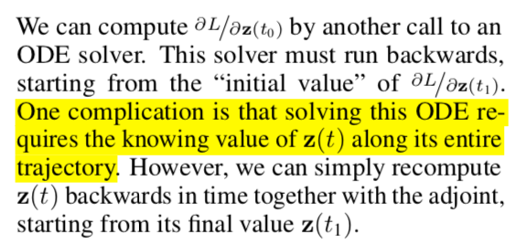
Adjoint Sensitivity Method
more can see: https://cs.stanford.edu/~ambrad/adjoint_tutorial.pdf

Slide 49
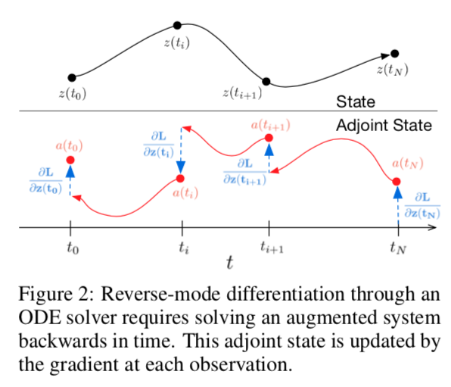

Slide 50
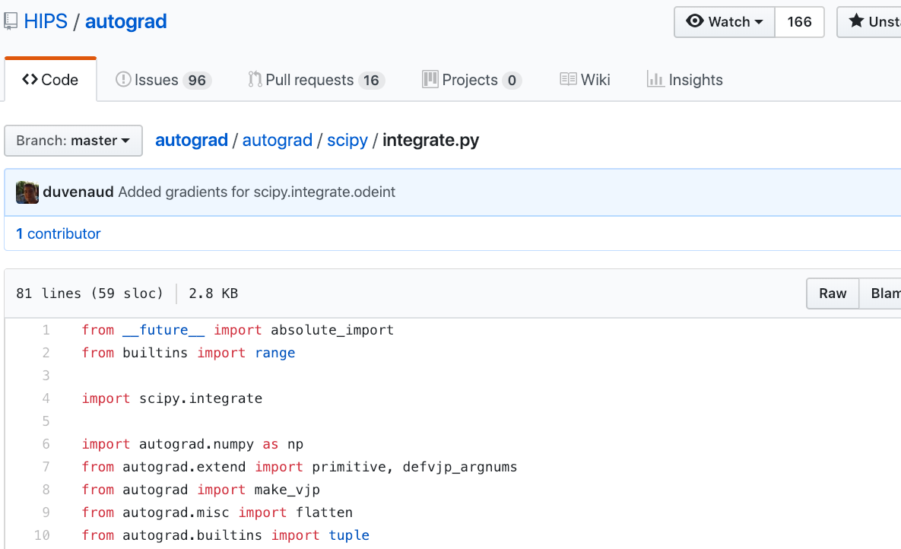
implementation of reverse ode is in the python package autograd
implement the grad of odeint function of scipy
an example: https://github.com/HIPS/autograd/blob/master/examples/ode_net.py

Slide 51
SCALABLE REVERSIBLE GENERATIVE MODELS WITH FREE-FORM CONTINUOUS DYNAMICS
https://openreview.net/pdf?id=rJxgknCcK7
sequel of Neural ODEs
SCALABLE DENSITY EVALUATION

Slide 53
UNBIASED LINEAR-TIME LOG-DENSITY ESTIMATION

Slide 55
Computational Analysis
discrete-time dynamics → continuous-time dynamics
O(D^3) → O(D^2)
O(D^2) : cost of introducing a numerical ODE solver

Slide 56
REDUCING VARIANCE WITH BOTTLENECK CAPACITY

Slide 58
Thank you for listening!

